Slide 1

ANDROID TV UI PARIWISATA TV

Slide 2
Anggota Kelompok
AKHDAN FAHRU RIZQI
ACHMAD SAIFULOH
DUTHA KHRIS PAHASARILLA
WIDIYA SETIYANINGRUM

Slide 3
100% 90% 80% 70% 60% 50% 40% 30% 20% 10%
Elemen
#1E1E1E
Background
#007BA4
Selected
Use color to side menu
Normal Button (No Frame)
Background Button : #1E1E1E
Font :
Inter Reguler
Hover Button, Corner radius 15, Size 20++
Background Button : #1E1E1E
Active Button
Background Button : #007BA4

Slide 4


Slide 5
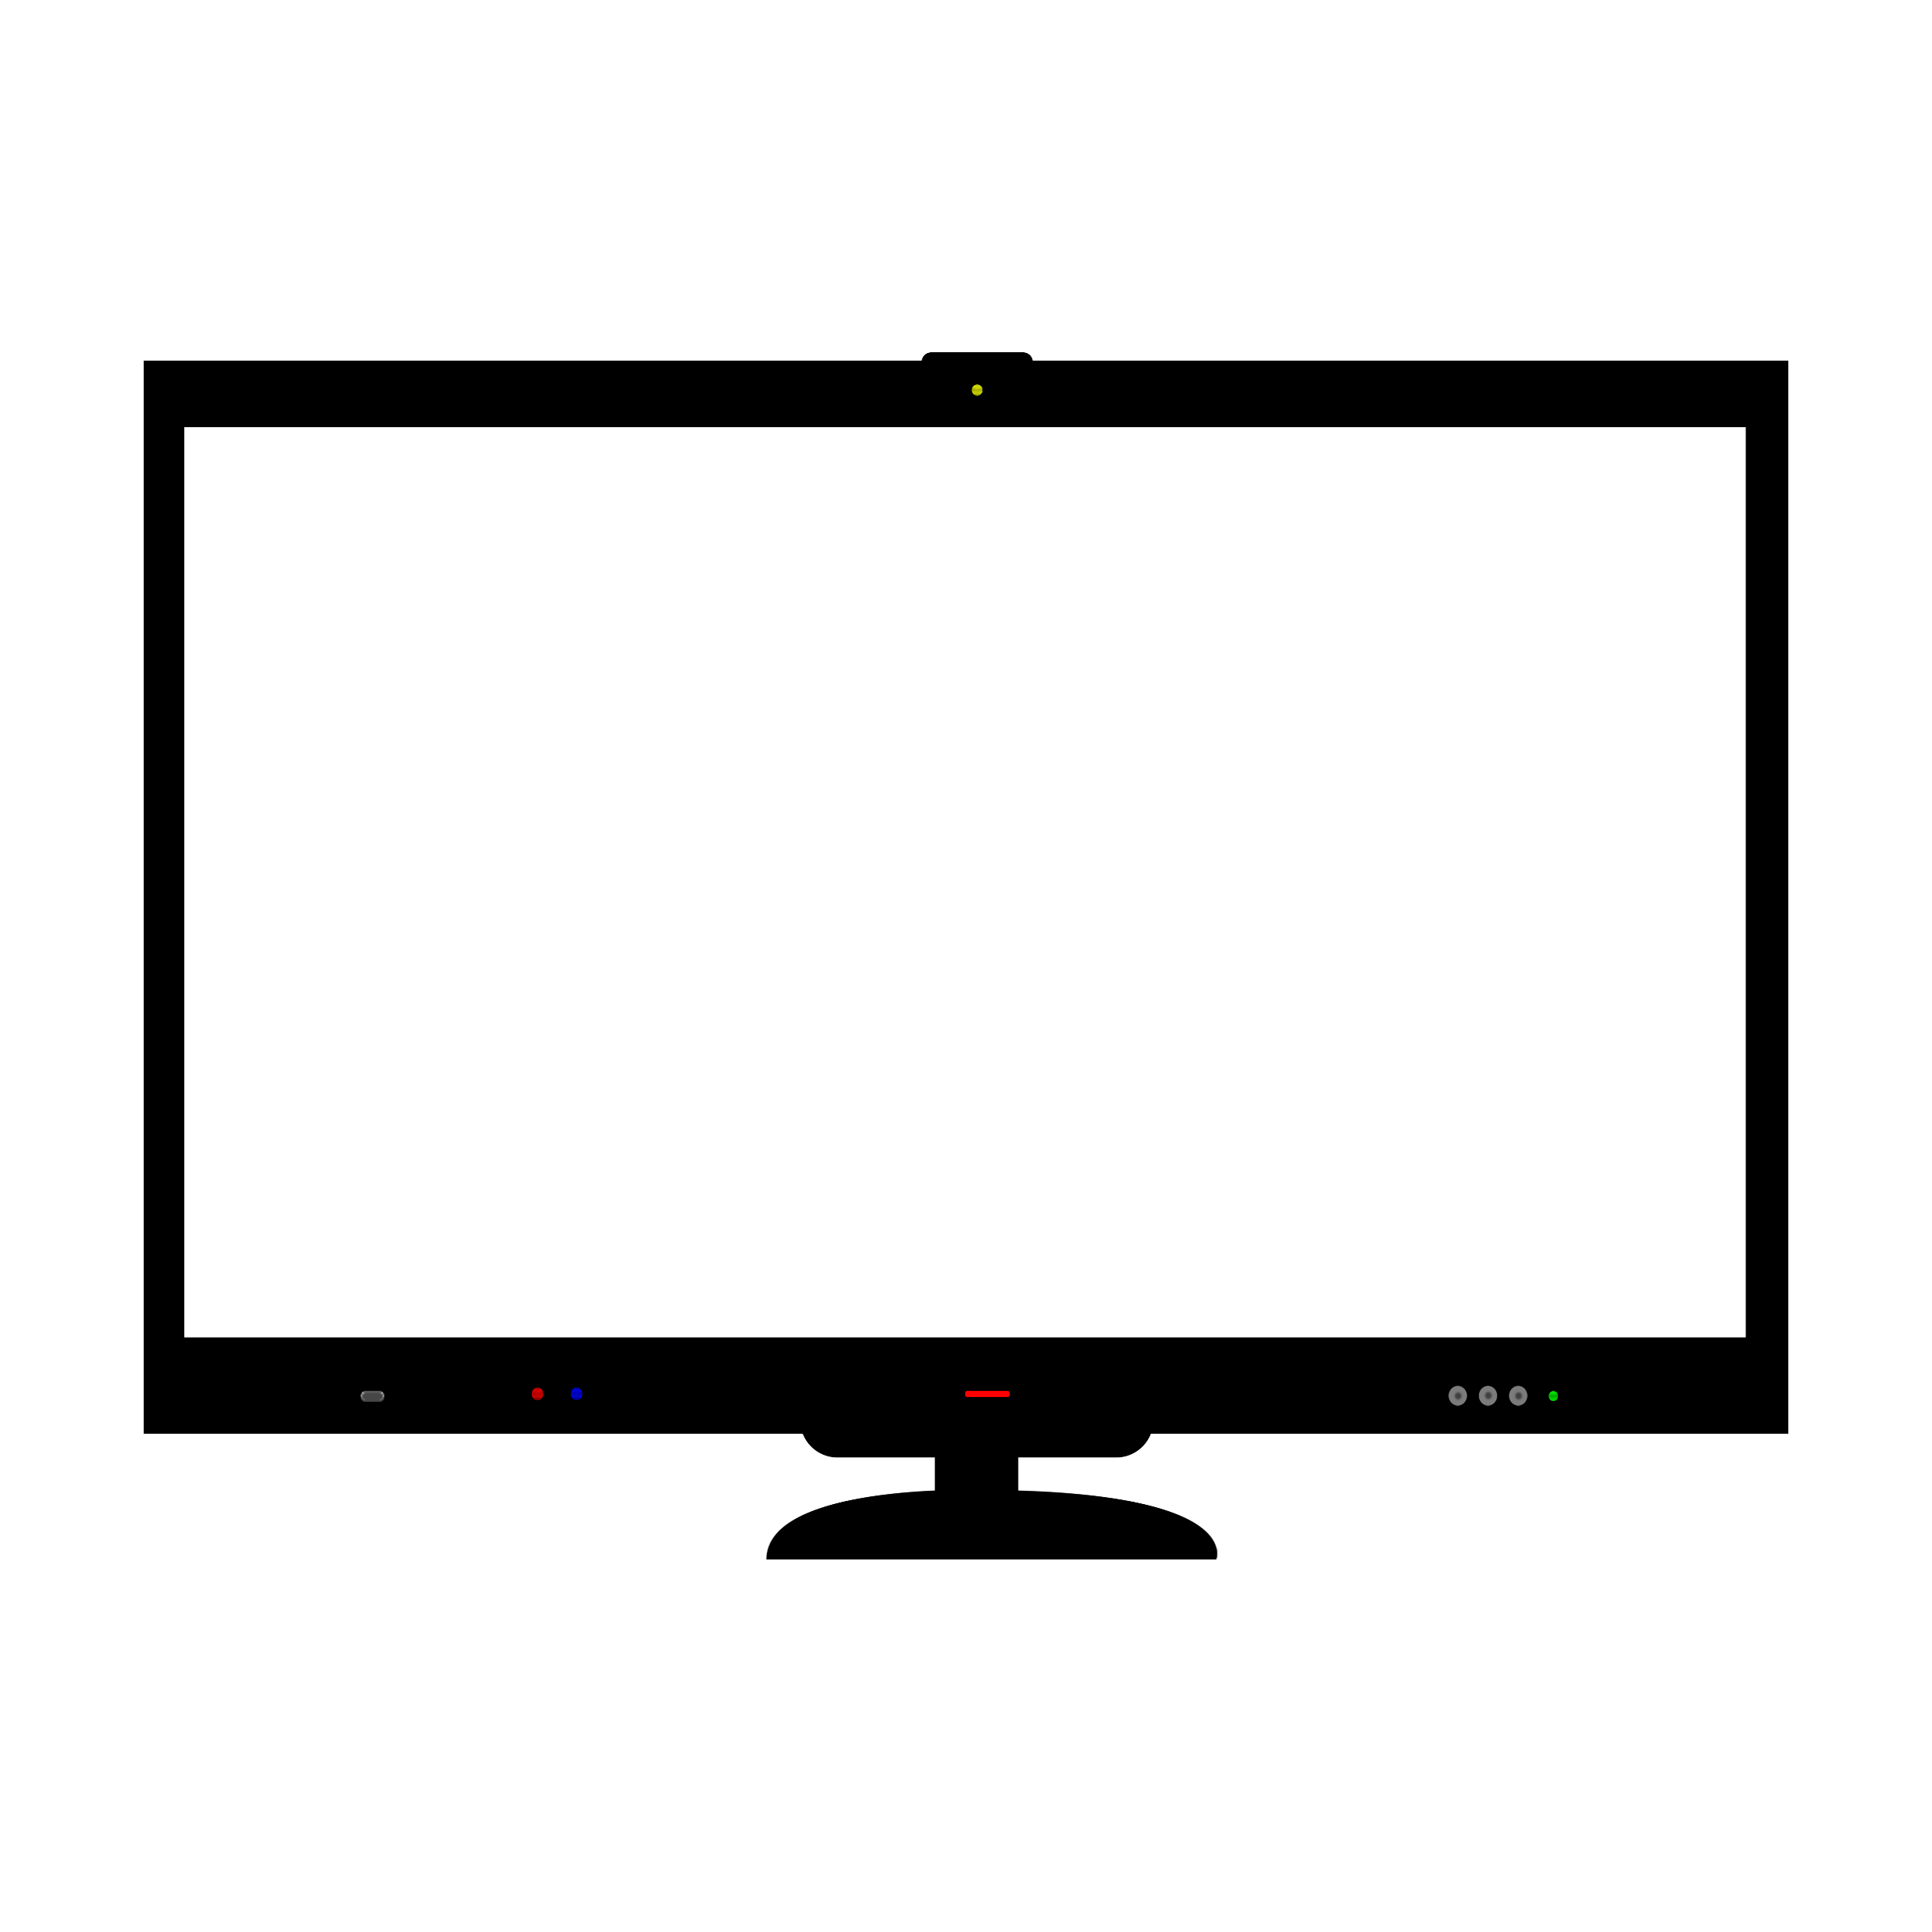
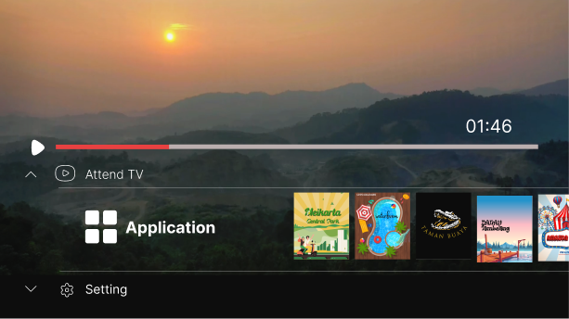
Dashboard
Background image
Opacity: 95%
Time
Inter regular
24 px
Tombol play
70 x 70
Continously
Sliding poster max 10 poster
Moving to menu
Inter Bold
36 px
Selected image to play video
123 x 150
Moving to setting
Inter Reguler
28 px

Slide 6
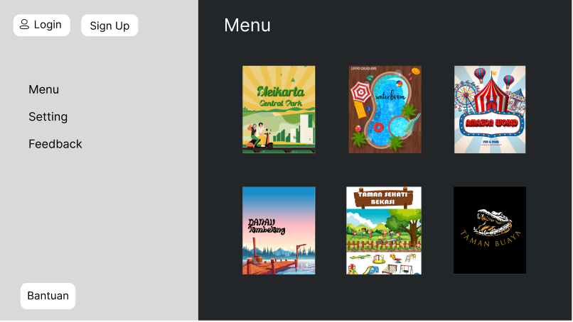
Menu
Tombol button
Corner radius 15
Inter regular
24px
Title
Inter regular
40px
Background
#232628
Button
Inter regular 26px
Side menu
#D9D9D9
100%
Selected image
162 x 192
Tombol button
Corner radius 15
Inter regular 24px

Slide 7
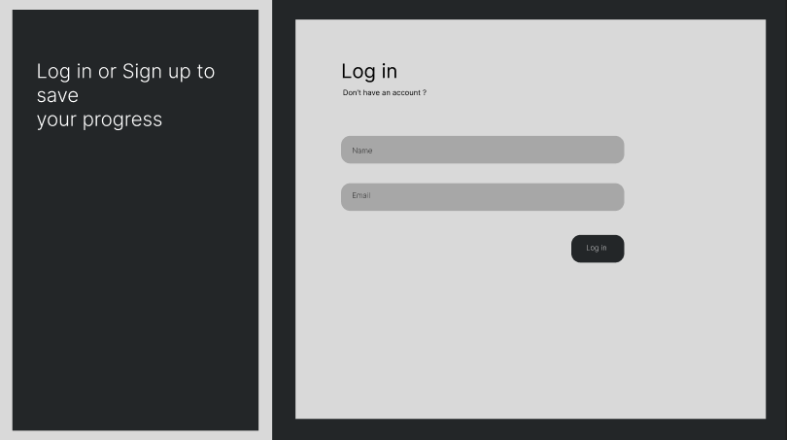
LOG IN
Tittle
Inter regular 40px
Text
Inter light
32px
Background
#1E1E1E
Edittext
#A7A7A7
Side menu
#232628
100%
Tombol Button
#232628
Margin
46px

Slide 8
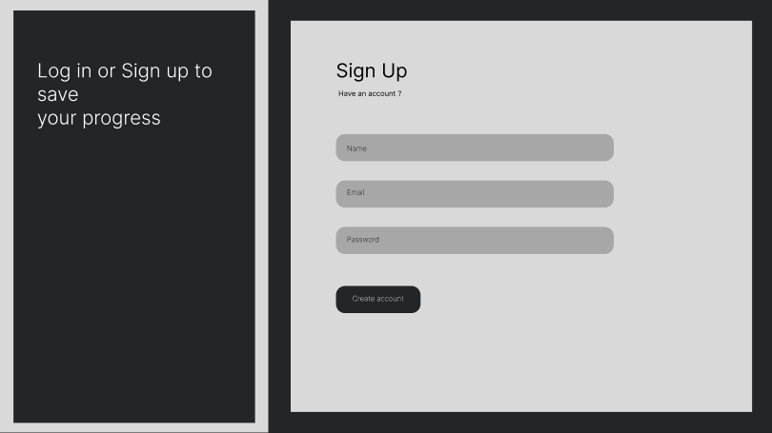
SIGN UP
Tittle
Inter regular
40px
Text
Inter light
32px
Background
#1E1E1E
Edittext
#A7A7A7
Corner radius 15
460 x 45
Side menu
#232628
100%
Tombol button
#232628
Corner radius 15
Inter regular
24px
140 x 45
Margin
46px

Slide 9
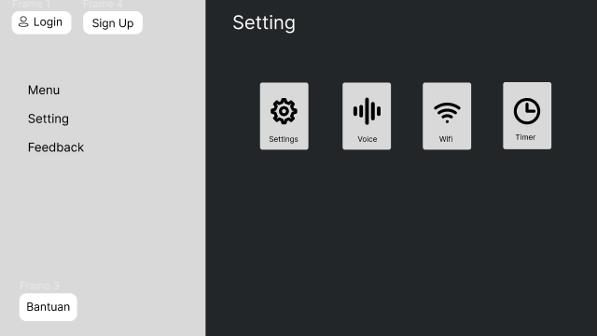
FEEDBACK
Tombol button
Corner radius 15
Inter regular 24px
Sub Tittle
Inter regular 40px
Button
Inter regular 26px
Icon
50x50
Rectangle
#D9D9D9
Inter reguler 16 px
Side menu
#D9D9D9
100%
Tombol button
Corner radius 15
Inter regular 24px

Slide 10
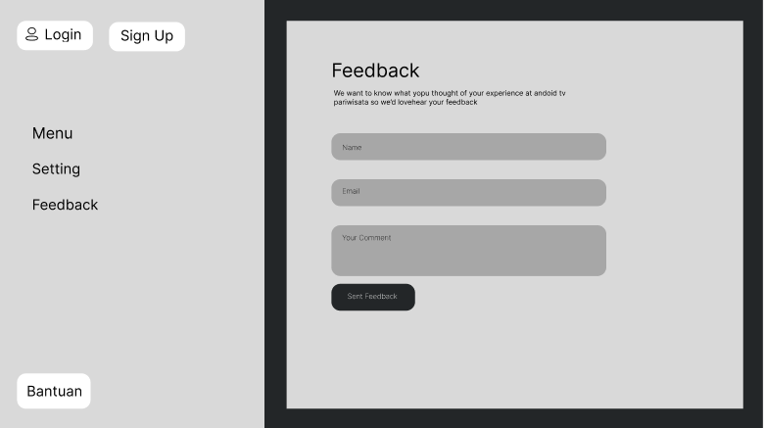
FEEDBACK
Tombol button
Corner radius 15
Inter regular 24px
Sub Tittle
Inter regular 40px
Greeting
Inter regular 20px
Button
Inter regular 26px
Background #1E1E1E
Edittext
#A7A7A7
Corner radius 15
Side menu
#D9D9D9
100%
Tombol button
#232628
Corner radius 15
Inter regular
24px
140 x 45
Tombol button
Corner radius 15
Inter regular 24px

